Slide 1





Customer Segmentation and Personalization
Team : santhosh J
Email : santhoshjawaharalal@gmail.com
Guide: (P.Raja, Master Trainer )
Disclaimer: The content is curated for educational purposes only.
Notes:
Slides: Prepare a short slide deck (10-12 slides) summarizing the project objectives, methodology, and key results.

Slide 2
OUTLINE
Abstract
Problem Statement
Proposed System/Solution
Algorithm & Deployment
GitHub Link
Project Demo(photos / videos)
Conclusion
Future Scope
References

Slide 3
Abstract
Customer segmentation and personalization are essential strategies in modern marketing that enable businesses to optimize customer engagement, enhance satisfaction, and drive sales. Customer segmentation involves dividing a diverse customer base into distinct groups based on shared characteristics, such as demographics, behavior, and preferences. This segmentation allows businesses to tailor marketing efforts and product offerings to specific customer needs. On the other hand, personalization goes a step further by customizing the experience for individual customers, utilizing data-driven insights to provide targeted recommendations, dynamic content, and individualized communications. Together, these strategies enable businesses to create more relevant, efficient, and engaging interactions with their customers, leading to increased customer loyalty, improved conversion rates, and greater overall business performance. The successful implementation of customer segmentation and personalization requires advanced data analytics, AI, and machine learning technologies to understand customer behaviors and preferences at scale.
.

Slide 4
Problem Statement
The problem with customer segmentation and personalization lies in effectively gathering, analyzing, and utilizing customer data to create meaningful, targeted experiences while addressing privacy concerns and data accuracy challenges. As businesses strive to improve customer engagement and drive conversions through personalized content, many face difficulties in obtaining reliable, comprehensive data across diverse channels. Additionally, segmentation strategies may not always accurately capture customer behaviors and preferences, leading to ineffective targeting. The complexity of real-time personalization, combined with the increasing demand for data security and compliance with privacy regulations, further complicates the implementation of these strategies. Businesses must find ways to balance personalization with privacy, ensure data accuracy, and scale their efforts efficiently to fully realize the benefits of customer segmentation and personalization..

Slide 5
Proposed Solution
By integrating advanced technologies, prioritizing privacy, and continuously optimizing the system, businesses can effectively leverage customer segmentation and personalization to improve customer engagement, satisfaction, and retention, while maximizing marketing ROI.

Slide 6
Github project link
https://github.com/SanthoshSandhu/naan-mudhalvan.git
Notes:
thank you very much for joining this PPT, keep learning.
6

Slide 7
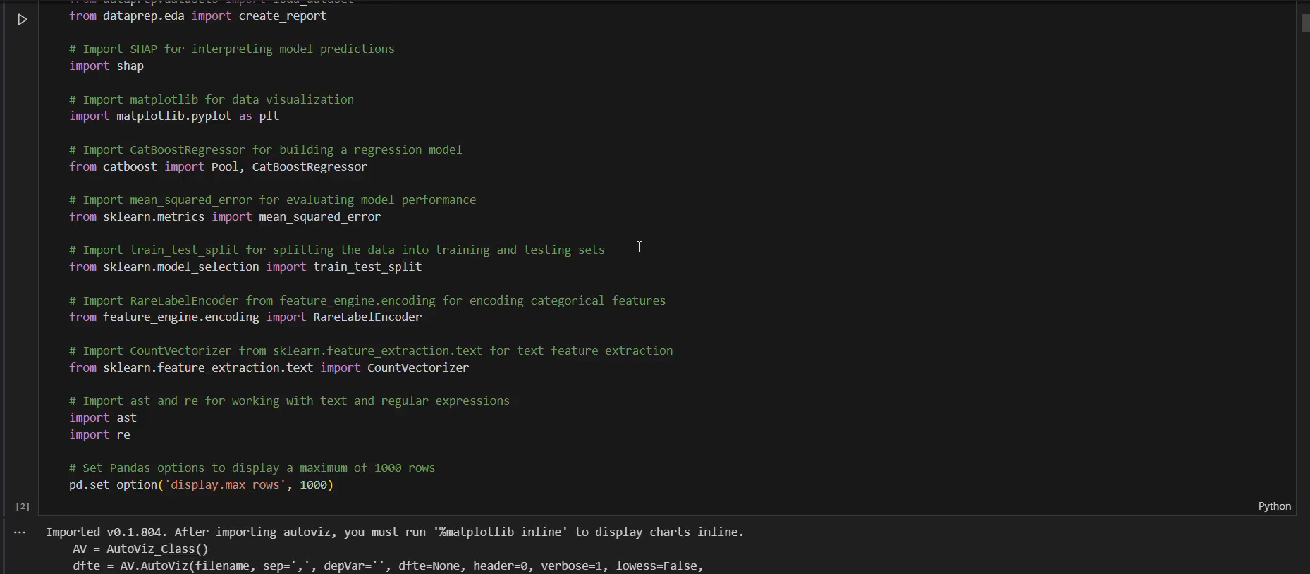
Video of Project Demo

Slide 8
Conclusion
customer segmentation and personalization are powerful strategies that can significantly enhance customer engagement, drive conversions, and foster long-term loyalty. By leveraging data to understand customer preferences, behaviors, and needs, businesses can deliver tailored experiences that resonate with specific customer groups. These strategies help optimize resource allocation, improve marketing ROI, and refine product offerings, making marketing efforts more efficient and effective. However, challenges such as data privacy concerns, the need for accurate data, and the complexity of personalization at scale must be carefully managed. When implemented thoughtfully, customer segmentation and personalization offer substantial benefits, creating stronger customer relationships and a competitive edge in the marketplace.

Slide 9
Future Scope
Real-time
adaptive
multilingual
predictive
scalable

Slide 10
Thank you!
Notes:
thank you very much for joining this PPT, keep learning.
10

